Slide 1


Social
Buzz

Slide 2


Project Recap
Problem
Today’s
agenda
The Analytics Team
Process
Insights
Summary

Slide 3

Client
Objective
Project
Recap
Social Buzz
IPO preparation and scalability management.
Deliverables
Timeline
Big data practices audit, IPO recommendations, and top content category analysis.
3 months.

Slide 4
Data Overload
Massive
Resource Limitations
Inability to manage scaling internally
IPO Preparation
Lack of expertise in data-driven IPO strategies
unstructured datasets
Problem

Slide 5


Marcus Rompton
Senior Principal
The Analytics Team
Ayush (ME)
Data Analyst
Andrew Fleming
Chief Technical Architect

Slide 6
Process
1
Data Cleaning
Removed missing values and standardized data types
2
Data Integration
Merged Reactions, Content, and Reaction Types datasets
3
Analysis
Grouped by content categories and calculated total scores
4
Visualization
Created charts to showcase category
performance and insights
5
Recommendations
Proposed scalable big data practices
and IPO strategies

Slide 7

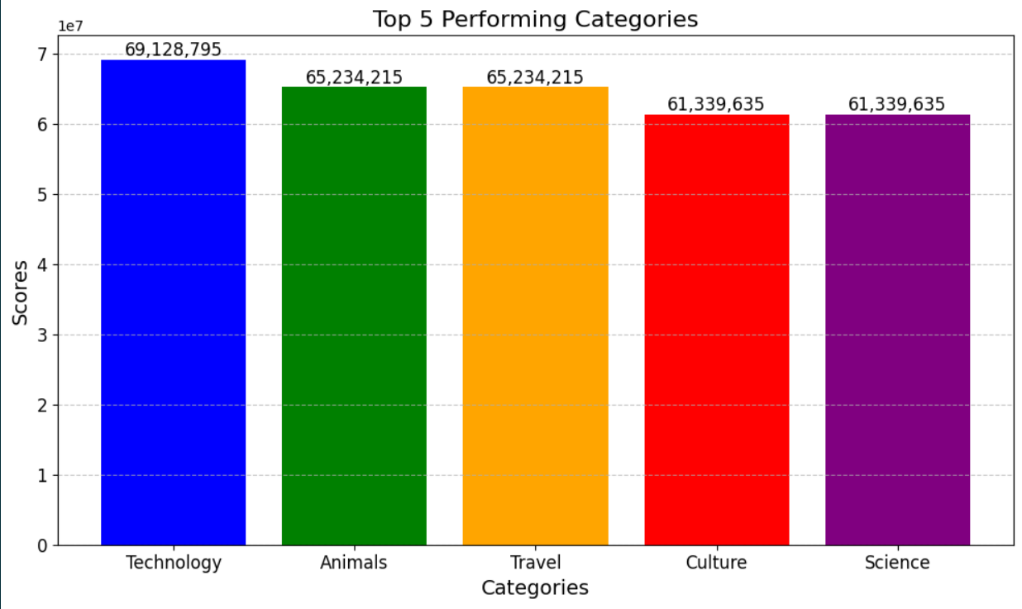
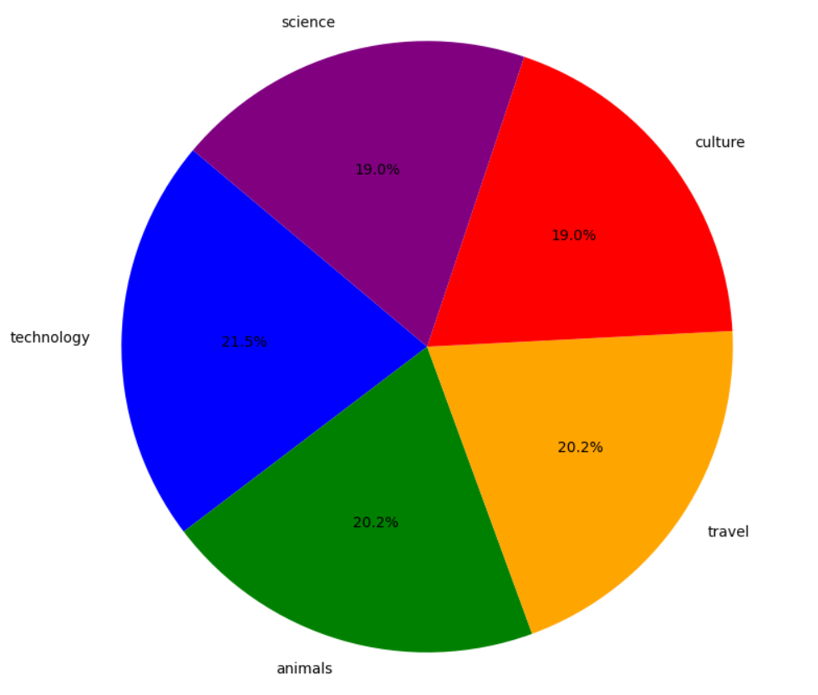

Insights

Slide 8
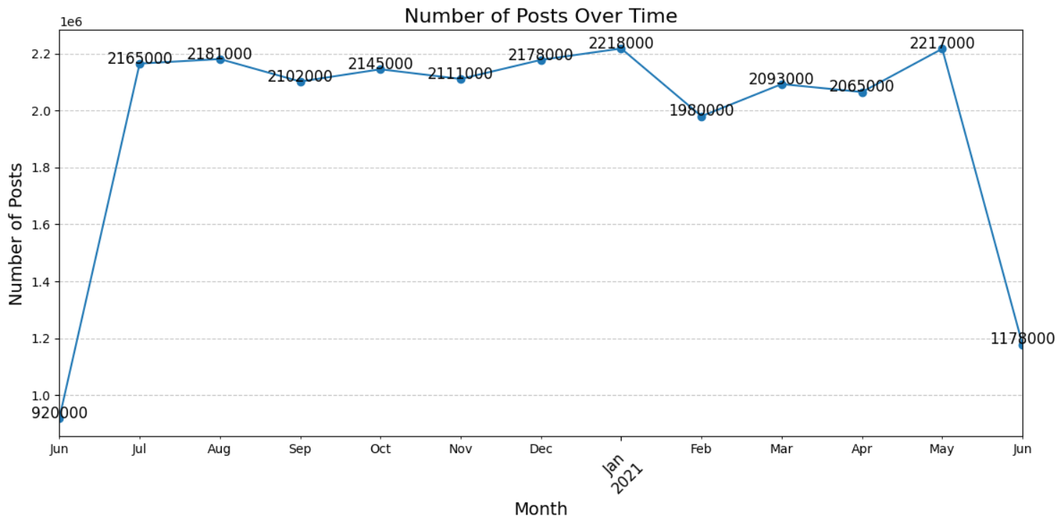

Slide 9

Content Diversity:
A Wide Audience Appeal
41 Unique Categories
Most popular category:
"technology" with 69128795 reactions
Month with the most posts:
January 2021, with 2218000 posts

Slide 10
Top 5 Content Categories
User Engagement Trends
Technology takes the lead with the highest engagement score of 69.1 million reactions. Other top performers include Animals, Travel, Culture, and Science. These categories drive significant user engagement and are key for future content strategies.
January 2021 saw a peak in platform activity with 2.2 million posts. This suggests seasonal trends or platform updates may influence posting behavior. Understanding these trends can inform future planning.
Summary
Diversity of Content
Key Recommendations
Focus on creating and promoting content in top-performing categories, especially Technology and Animals. Analyze posting trends to refine marketing strategies and optimize content release schedules. Leverage the diversity of categories to explore new opportunities for engagement and revenue growth.
The platform hosts 41 unique categories, catering to diverse user interests. This diversity is a key driver of user retention and platform growth.
Next Steps
Implement targeted campaigns for the top 5 categories
Analyze seasonal posting trends to refine marketing strategies
Continue monitoring performance metrics for data-driven decision-making

Slide 11
Thank you!
ANY QUESTIONS?

